Slide 1

Ellie AWS Lex Bot: ETF Analysis & Selection
FinTech Bootcamp: Project #2
December 21, 2021
Giselle Tarabolleti, Brian Miller and Erin Kenny
GitHub HTTPS to Clone Repo:
Project_2 GITHUB Link

Slide 2

Agenda
Executive Summary
Ellie Chatbot – Python and AWS data model
Data analysis review
SPDR ETF Overview
Risk/Return results deep dive
Lex chatbot working demo
Conclusions and next steps

Slide 3

Executive Summary
ETF sector specific funds are under-utilized as a potential investment opportunity for younger investors.
The goal of this project is to start development of an AWS Lex chatbot to recommend ETF holdings to interested investors, which will likely be Gen Z’ers and Millennials.
Specifically, our bot recommends SPDR industry ETFs, as they are widely reported on and easier to grasp for new investors.
We start by separately examining historical ETF risk/return trends for the S&P500 sector specific funds (11 total) and return multiple metrics to the user based on their selections in Lex.
The final recommendation provided by Ellie is determined by fulfillment of 6 intents, capturing user data in 10 slots, invoking two Lambda functions, and storing results in DynamoDB.

Slide 4

Ellie Chatbot – Python and AWS data model
Let’s dive in

Slide 5








Ellie Chatbot data model
Ellie Users ask for ETF, Bonds, or Stocks and Financial Predictions
Local Python tools push data to AWS S3
AWS Cloud Services workflow
S3 Client
Call functions
DyDB Client
Python Modules
[InvestPy, Pandas, Numpy, HvPlot, JSON, Boto3]
Jupyter Notebook
[Python 3.7+ kernels, ETF data analysis, risk/return plots, build JSON file, boto3 client to AWS S3]
Amazon Simple Storage Service (S3)
[Bucket=Ellie, Key=Returns.JSON]
AWS Lambda
[Functions: EllieBackStage_GT, Ellie_Sector_Selector, Python 3.7+ runtime]
Amazon Lex
[ProjectRoboAdvisor:
Intents(6), Slots(10), FullAccess roles to interact with S3, Lambda, DynamoDB]
Amazon DynamoDB
[Table: ETF_Request_2,
Items: id, sector]
App on back-end continues to refresh data daily
Amazon CloudWatch
[Review logs of AWS resources]

Slide 6
SPDR ETF Overview
Investopedia.com: “An exchange traded fund (ETF) is a type of security that tracks an index, sector, commodity, or other asset, but which can be purchased or sold on a stock exchange the same way a regular stock can.”
The Lex application currently provides recommendations and analytics for the following S&P 500 sector specific ETF funds. This group of ETF funds are among the most well-known in the industry.

Slide 7
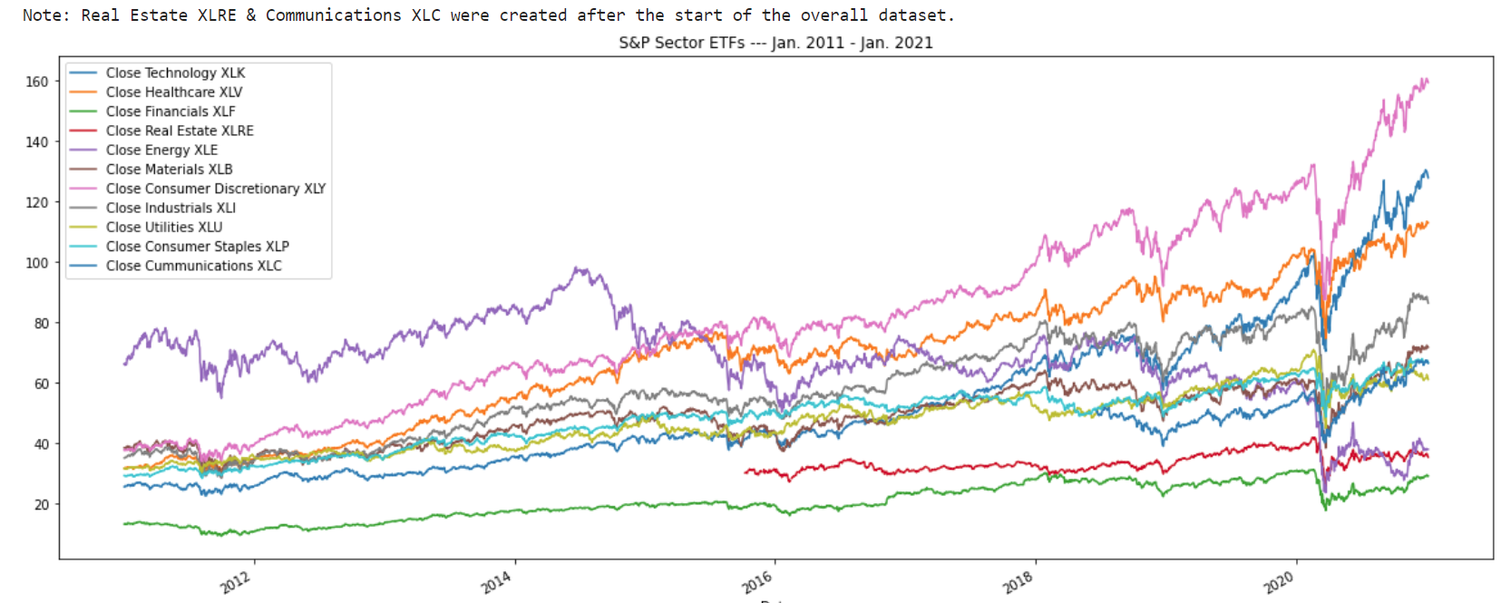
SPDR ETF price trends (2011 – 2020)
The onset of the pandemic resulted in a sharp dip in all ETF funds for a short period in 2020.
The S&P500 index has continued to reach all-time highs and in the dataset below (and in the previous page) all sectors closing stock prices have increased significantly later in 2020 through December 2021.
Recovery
Covid dip

Slide 8
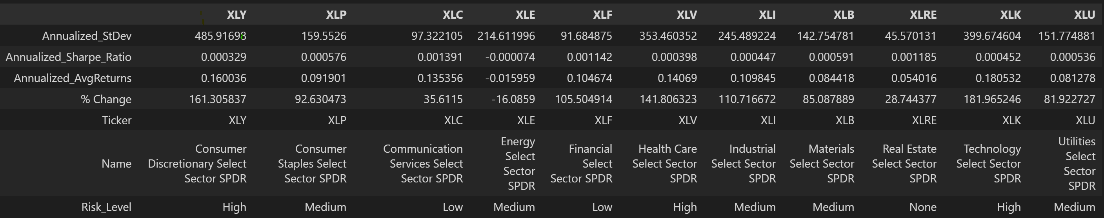
ETF aggregated risk/return results
The risk/return data was aggregated into a combined dataframe and delivered to the AWS environment as a JSON file following the data model presented in slide #5.
Below is the screenshot of the final aggregated dataset sent to Ellie. Ellie returns data to the user when a single ETF sector is selected.
Please note that the data highlighted for ticker XLY represents the values Ellie will return in the demo video and transcript provided on the next slides. Additionally, Ellie records a unique id and the sector name each time the app is used. A screenshot is also provided to show the saved data in Amazon DynamoDB.

Slide 9
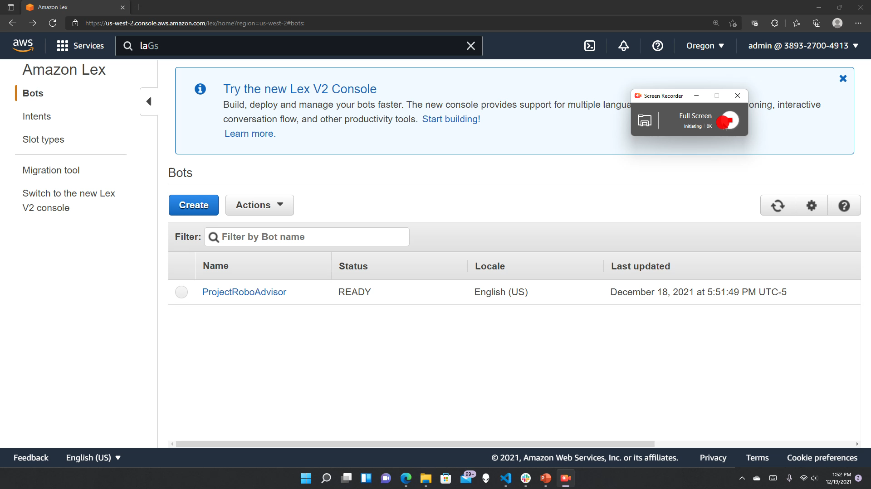
Ellie Lexbot demo video

Slide 10
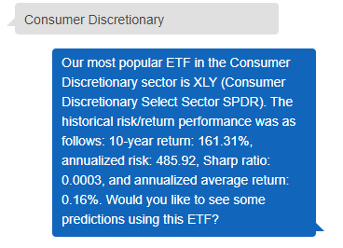
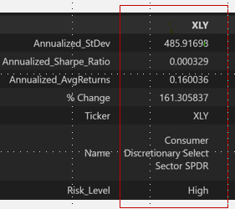
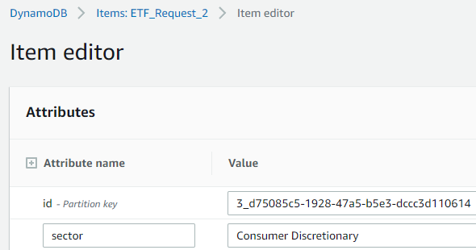
Ellie Lexbot screenshots

Slide 11

Conclusion and….
By exploring this process, the team strengthened and gained a broader exposure to a variety of tools available in the AWS suite
Working on a larger scale application was a new challenge for the team and helped us learn to delegate work based on team members current knowledge, intellectual curiosity, and strengths
….Next steps
Explore more efficient ways to exchange, store, retrieve, and analyze data leveraging additional AWS services
Continue build out of the Ellie LexBot by completing the Stocks, Bonds, Corps, and Financial Analysis intents and deploying as a smartphone app
Strengthen knowledge of tools and techniques for integrating and deploying code in AWS/cloud

